Slide 1
School of Computing Science and Engineering
Course Code: BCSE2350 Course Name: Cryptographic Fundamental
Conventional Encryption Message Confidentiality

Slide 2
Outline
Conventional Encryption Principles
Conventional Encryption Algorithms
Cipher Block Modes of Operation
Location of Encryption Devices
Key Distribution

Slide 3
Symmetric Encryption
A.k.a. conventional / secret-key / single-key
Sender and recipient share a common key
All classical encryption algorithms are secret-key-based
Was the only type prior to the invention of public-key in 1970’s
By far most widely used
Notes:
Symmetric encryption, also referred to as conventional encryption or single-key encryption, was the only type of encryption in use prior to the development of public-key encryption in the 1970s. It remains by far the most widely used of the two types of encryption. All traditional schemes are symmetric / single key / private-key encryption algorithms, with a single key, used for both encryption and decryption. Since both sender and receiver are equivalent, either can encrypt or decrypt messages using that common key.

Slide 4
Conventional Encryption Principles
An encryption scheme has five ingredients:
Plaintext
Encryption algorithm
Secret key
Ciphertext
Decryption algorithm
Security depends on the secrecy of the key, not the secrecy of the algorithm
Why?

Slide 5
Conventional Encryption Principles

Slide 6
Cryptography
Characterize cryptographic systems by:
Type of encryption operations used
Substitution / transposition / product
Some examples will be discussed later
Number of keys used
Single-key or secret / two-key or public
Way in which plaintext is processed
Block / stream
Notes:
Cryptographic systems can be characterized along these three independent dimensions.

Slide 7
Brute Force Search (Exhaustive Key Search)
Always possible to simply try every key
Most basic attack, proportional to key size
Assume either know / recognize plaintext
Average time (1/2)
Key Size (bits) | Number of Alternative Keys | Time required at 1 decryption/µs | Time required at 10⁶ decryptions/µs
32 | 2³² = 4.3 × 10⁹ | 2³¹ µs = 35.8 minutes | 2.15 milliseconds
56 | 2⁵⁶ = 7.2 × 10¹⁶ | 2⁵⁵ µs = 1142 years | 10.01 hours
128 | 2¹²⁸ = 3.4 × 10³⁸ | 2¹²⁷ µs = 5.4 × 10²⁴ years | 5.4 × 10¹⁸ years
168 | 2¹⁶⁸ = 3.7 × 10⁵⁰ | 2¹⁶⁷ µs = 5.9 × 10³⁶ years | 5.9 × 10³⁰ years
26 letters (permutation) | 26! = 4 × 10²⁶ | 2 × 10²⁶ µs = 6.4 × 10¹² years | 6.4 × 10⁶ years
Notes:
A brute-force attack involves trying every possible key until an intelligible translation of the ciphertext into plaintext is obtained. On average, half of all possible keys must be tried to achieve success. Stallings Table 2.2 shows how much time is required to conduct a brute-force attack, for various common key sizes (DES is 56, AES is 128, Triple-DES is 168, plus general mono-alphabetic cipher), where either a single system or a million parallel systems, are used.

Slide 8
Classical Feistel Cipher Structure
By Horst Feistel of IBM in 1973
Virtually all conventional block encryption algorithms (including DES) use this structure
The realization of a Feistel Network depends on
the choice of a number of parameters and design features

Slide 9
Feistel Cipher Structure
Block size
larger block sizes mean greater security
Key Size
larger key size means greater security
Number of rounds
multiple rounds offer increasing security
Subkey generation algorithm
greater complexity will lead to greater difficulty of cryptanalysis.
Fast software encryption/decryption
the speed of execution of the algorithm becomes a concern

Slide 11
Conventional Encryption Algorithms
Data Encryption Standard (DES)
The most widely used encryption scheme
The algorithm is reffered to as the Data Encryption Algorithm (DEA)
DES is a block cipher
The plaintext is processed in 64-bit blocks
The key is 56-bits in length (original version)

Slide 12
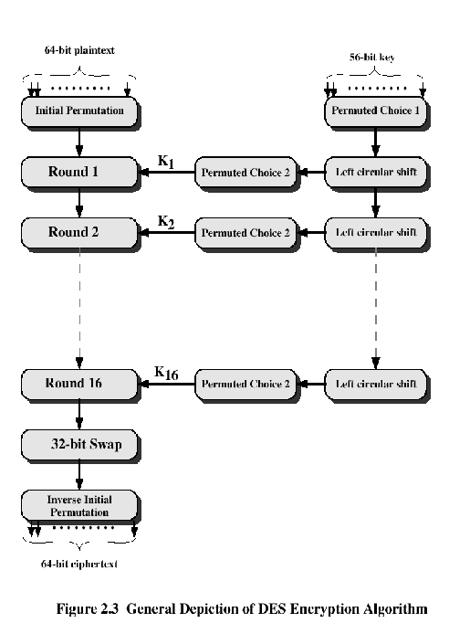

Slide 13
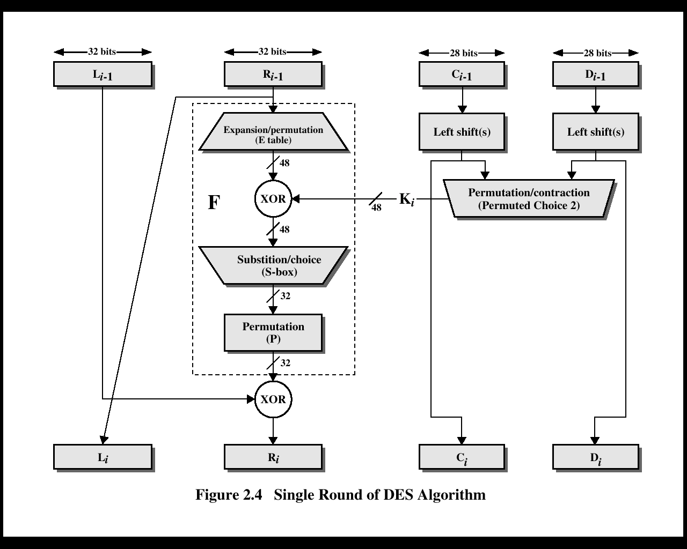

Slide 14
DES
Mathematically, the overall processing at each iteration:
Li = Ri-1
Ri = Li-1 F(Ri-1, Ki)
Concerns about:
The algorithm and the key length (56-bits)

Slide 15
Time to break a code (10⁶ decryptions/µs)

Slide 16
Alternatives to DES
A replacement for DES was needed
Have theoretical attacks that can break it
have demonstrated exhaustive key search attacks
A strengthened DES
Triple-DEA (Triple-DES)
Notes:
Since its adoption as a federal standard, there have been lingering concerns about the level of security provided by DES in two areas: key size and the nature of the algorithm.
With a key length of 56 bits, there are 2^56 possible keys, which is approximately 7.2*10^16 keys. Thus a brute-force attack appeared impractical.
However DES was finally and definitively proved insecure in July 1998, when the Electronic Frontier Foundation (EFF) announced that it had broken a DES encryption using a special-purpose "DES cracker" machine that was built for less than $250,000. The attack took less than three days. The EFF has published a detailed description of the machine, enabling others to build their own cracker [EFF98].
There have been other demonstrated breaks of the DES using both large networks of computers & dedicated h/w, including:
- 1997 on a large network of computers in a few months
- 1998 on dedicated h/w (EFF) in a few days
- 1999 above combined in 22hrs!
It is important to note that there is more to a key-search attack than simply running through all possible keys. Unless known plaintext is provided, the analyst must be able to recognize plaintext as plaintext.
Clearly must now consider alternatives to DES, the most important of which are AES and triple DES.

Slide 17
Triple DEA
Use three keys and three executions of the DES algorithm (encrypt-decrypt-encrypt)
C = ciphertext
P = Plaintext
EK[X] = encryption of X using key K
DK[Y] = decryption of Y using key K
Effective key length of 168 bits (3x56)
C = EK3[DK2[EK1[P]]]

Slide 18
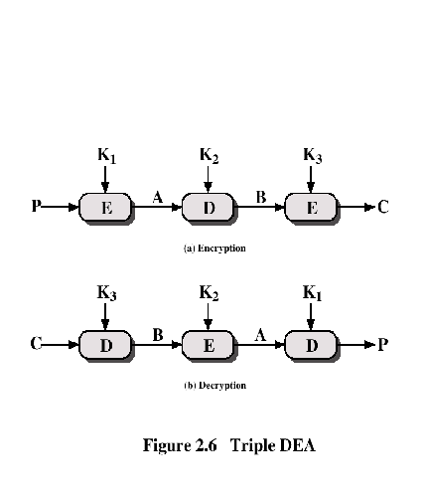
Triple DEA

Slide 19
Alternatives to DES
Triple-DES
Slow
Use small blocks
AES Cipher – Rijndael
Designed by Joan. Daemen and Vincent Rijmen in Belgium
Has 128/192/256-bit keys, 128-bit data
An iterative rather than feistel cipher
Processes data as block of 4 columns of 4 bytes
Operates on entire data block in every round
Notes:
Since its adoption as a federal standard, there have been lingering concerns about the level of security provided by DES in two areas: key size and the nature of the algorithm.
With a key length of 56 bits, there are 2^56 possible keys, which is approximately 7.2*10^16 keys. Thus a brute-force attack appeared impractical.
However DES was finally and definitively proved insecure in July 1998, when the Electronic Frontier Foundation (EFF) announced that it had broken a DES encryption using a special-purpose "DES cracker" machine that was built for less than $250,000. The attack took less than three days. The EFF has published a detailed description of the machine, enabling others to build their own cracker [EFF98].
There have been other demonstrated breaks of the DES using both large networks of computers & dedicated h/w, including:
- 1997 on a large network of computers in a few months
- 1998 on dedicated h/w (EFF) in a few days
- 1999 above combined in 22hrs!
It is important to note that there is more to a key-search attack than simply running through all possible keys. Unless known plaintext is provided, the analyst must be able to recognize plaintext as plaintext.
Clearly must now consider alternatives to DES, the most important of which are AES and triple DES.

Slide 20
Other Symmetric Block Ciphers
International Data Encryption Algorithm (IDEA)
128-bit key
Used in PGP
Blowfish
Easy to implement
High execution speed
Run in less than 5K of memory

Slide 21
Other Symmetric Block Ciphers
RC5
Suitable for hardware and software
Fast, simple
Adaptable to processors of different word lengths
Variable number of rounds
Variable-length key
Low memory requirement
High security
Data-dependent rotations
Cast-128
Key size from 40 to 128 bits
The round function differs from round to round

Slide 22
Cipher Block Chaining Modes of Operation
Cipher Block Chaining (CBC) Mode
The input to the encryption algorithm is the XOR of the current plaintext block and the preceding ciphertext block.
Repeating pattern of 64-bits are not exposed

Slide 23
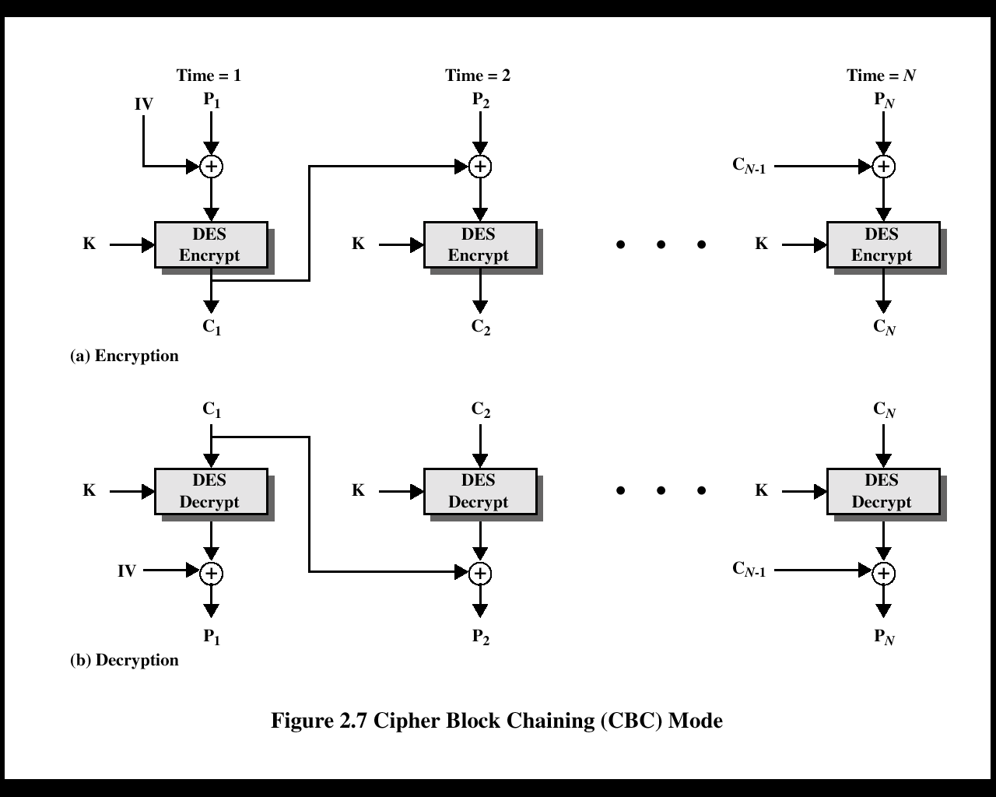

Slide 24
Location of Encryption Device
Link encryption:
A lot of encryption devices
High level of security
Decrypt each packet at every switch
End-to-end encryption
The source encrypts and the receiver decrypts
Payload encrypted
Header in the clear
High Security
Both link and end-to-end encryption are needed

Slide 26
Key Distribution
Physical delivery
A key could be selected by A and physically delivered to B.
A third party could select the key and physically deliver it to A and B.
Network transfer
If A and B have previously used a key, one party could transmit the new key to the other, encrypted using the old key.
If A and B each has an encrypted connection to a third party C, C could deliver a key on the encrypted links to A and B.
Diffie-Hellman key exchange

Slide 27
Session and Permanent Key
Session key:
Data encrypted with a one-time session key
At the conclusion of the session, the key is destroyed
Permanent key:
Used between entities for the purpose of distributing session keys

